Slide 1
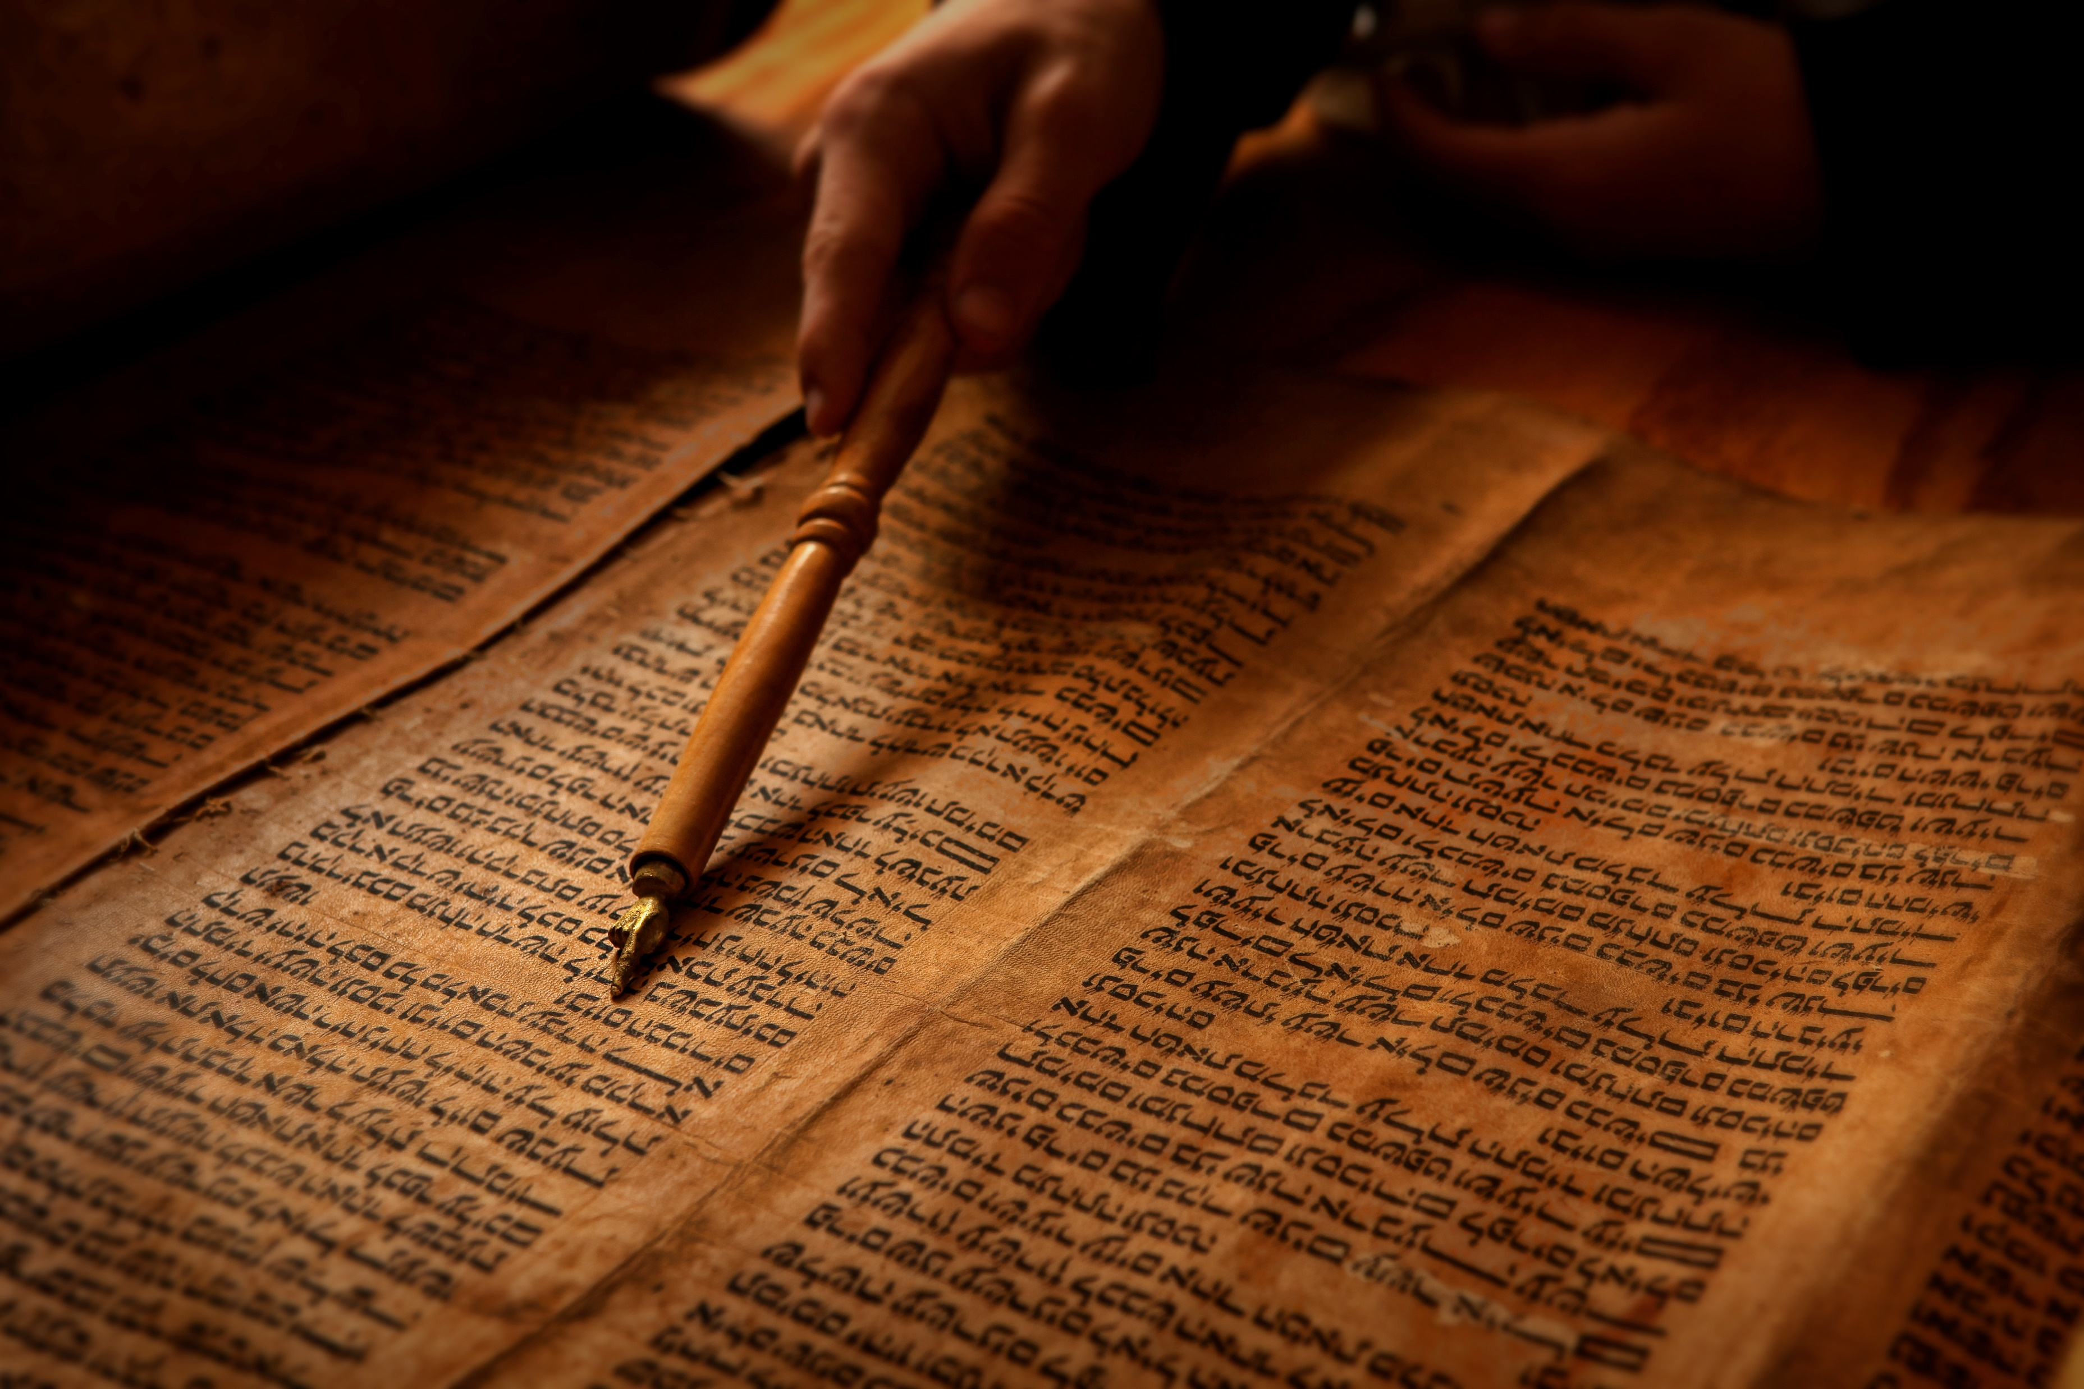
BIBLE BASICS 101
Part two
The
OLD Testament
Part two
The
OLD Testament
September 19, 2021
© 2021 Bob Highlands III
Notes:
Let’s be honest the Old Testament at times seems long boring and filled with facts, people and events we don’t understand or really care about. The questions are, “Why do Christians need to read or study the Old Testament? Since we have the New Testament is any of the Old Testament even relevant to us today?
I mean in exodus 16.36 it says, and I quote, “(An omer is one tenth of an ephah.)
Really, that is so exciting. My spiritual depth has now grown and I am ready to take on the enemies of darkness.
Everything is not exciting, and may not apply to you but I guarantee God put it there for a reason. I may not know that reason but it is there for a reason.

Slide 2
Old Testament Facts
Made up of 39 Books = 17 historical, 5 poetical, 17 prophetic.
929 chapters which took about 1500 years to write.
All the books of the Old Testament EXCEPT Esther, Ecclesiastes and the Song of Solomon are quoted in the New Testament, and there are about 300 quotations in all.

Slide 3
The Old Testament Facts
The LONGEST book in the Bible is the book of Psalms with 150 chapters. The SHORTEST book in the O.T. is Obadiah with just 21 verses
The PHRASES Apple of my Eye, Wolf in Sheep’s Clothing, The Skin of Your Teeth, and A Drop in the Bucket all originated in the Bible.
Notes:
Proverbs 7:2: "Keep my commands and you will live; guard my teachings as the apple of your eye.
". In fact it appears in 5 verses.
Beware of false prophets, which come to you in sheep's clothing, but inwardly they are ravening wolves (Gospel of Matthew 7:15, King James Version)
In Job 19:20, the ESV of the Bible says, I am nothing but skin and bones; I have escaped with only the skin of my teeth. In the Geneva Bible, the phrase is rendered as "I have escaped with the skinne of my tethe."
The phrase a drop in the bucket has been in use since the 1300s, and is derived from a passage in the Bible found in Isaiah 40:15: “Behold, the nations are as a drop of a bucket, and are counted as the small dust of the balance…”

Slide 4
The Old Testament
Is a DICTIONARY (PROPITIATION)
Is an ENCYCLOPEDIA
Is a HISTORICAL record
Is a SHADOW of N.T. Heb. 10.1
Is a TYPE to learn from 1 Cor. 10.6
Notes:
to make propitiation for the sins of the people. Hebrews 2.17 it is here God spoke to the people and received their offerings. Leviticus 16.14 “Then he shall kill the goat of the sin offering that is for the people and bring its blood inside the veil and do with its blood as he did with the blood of the bull, sprinkling it over the mercy seat and in front of the mercy seat.
An is a reference work or compendium providing summaries of knowledge either from all branches or from a particular field or discipline. In this case the Encyclopedia of God’s work to restore humanity.
Of the Jewish people, showing their historical journey in the middle east and their rise and fall as the people of God.
Heb 10.1 For the law having a shadow of the coming good things–
See next slide…

Slide 5
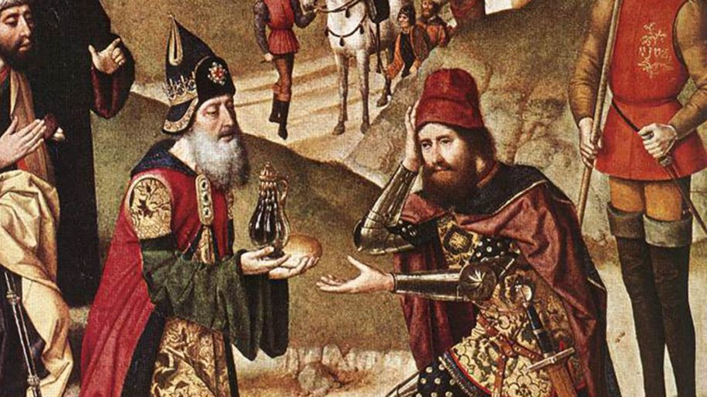
Melchizedek
Then MELCHIZEDEK KING of SALEM brought out BREAD and WINE. He was priest of God Most High, ^{Genesis 14.18}
A PRIEST after the order of Melchizedek ^{Hebrews 6.20}
KING of PEACE and Righteousness ^{Hebrews 7.2}
The Last Supper FORESHADOWED ^{MT 26.26-29}

Slide 6
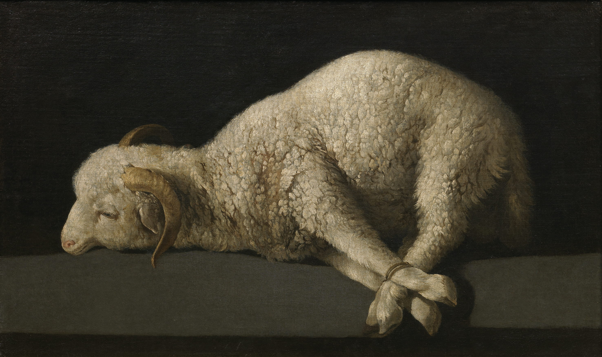
A Lamb Without Blemish
The animals you choose must be year-old males WITHOUT DEFECT, and you may take them from the sheep or the goats. Exodus 12.5
Heb 9.14 offered himself without BLEMISH to God,
1 Peter 1.19 with the precious blood of Christ, a lamb WITHOUT BLEMISH or defect.
Hebrews 4.15 (Jesus was) tempted in every way, just as we are—yet was WITHOUT SIN.

Slide 7
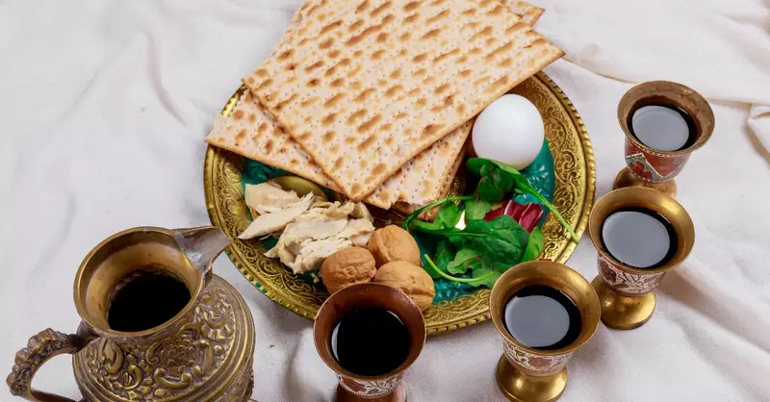
PASSOVER
Christ, our PASSOVER lamb, has been sacrificed. 1 Cor 5.7
EXODUS 12.21-27
The animal (lamb) was selected WITHOUT BLEMISH.
The Lamb had to die for the family’s SALVATION.
The BLOOD of the lamb SEPARATED them from the coming punishment.
HYSSOP is used to apply the blood.
The BLOOD represents the CROSS of Christ.
‘It is the Passover SACRIFICE to the LORD,
Notes:
Exodus 12.21-27
[21] Then Moses summoned all the elders of Israel and said to them, “Go at once and select the animals for your families and slaughter the Passover lamb. [22] Take a bunch of hyssop, dip it into the blood in the basin and put some of the blood on the top and on both sides of the doorframe. Not one of you shall go out the door of his house until morning. [23] When the LORD goes through the land to strike down the Egyptians, he will see the blood on the top and sides of the doorframe and will pass over that doorway, and he will not permit the destroyer to enter your houses and strike you down.
[24] “Obey these instructions as a lasting ordinance for you and your descendants. [25] When you enter the land that the LORD will give you as he promised, observe this ceremony. [26] And when your children ask you, ‘What does this ceremony mean to you?’ [27] then tell them, ‘It is the Passover sacrifice to the LORD, who passed over the houses of the Israelites in Egypt and spared our homes when he struck down the Egyptians.’”
Psalm 51:7,“Purge me with hyssop and I shall be clean; wash me, and I shall be whiter than snow.”
John 19.28 Jesus said, “I am thirsty.” A jar of wine vinegar was there, so they soaked a sponge in it, put the sponge on a stalk of the hyssop plant, and lifted it to Jesus’ lips. When he had received the drink, Jesus said, “It is finished.” With that, he bowed his head and gave up his spirit.

Slide 8
PASSOVER
Exodus 6.6-76 “Therefore, say to the Israelites: ‘I am the LORD, and I will bring you out from under the yoke of the Egyptians. I will free you from being slaves to them, and I will redeem you with an outstretched arm and with mighty acts of judgment. I will take you as my own people, and I will be your God. Then you will know that I am the LORD your God, who brought you out from under the yoke of the Egyptians.
he took a CUP, and when he had given thanks he gave it to them, and they all drank of it. Mark 14.21
… I will not DRINK …until …I drink it new in the kingdom of God.” Mk 14.25
Notes:
Seder meal is celebrated by Jewish people to remember their deliverance from slavery and their promised coming Messiah. Cup of
Four cups of wine: two during the meal and two after.

Slide 9
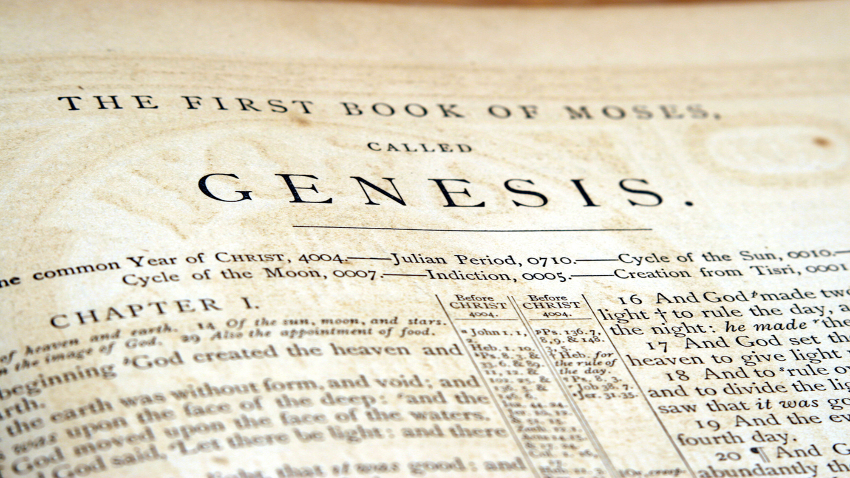
Why we NEED the O.T.
ALL SCRIPTURE is God breathed and profitable for the believer. ^{2 Tim. 3.16-17}
The Old Testament Explains the New Testament. Hebrews 11 BARAK
The Old Testament Reveals CHRIST JESUS over and over.
Genesis 1.26 “Let US make man in OUR image, in OUR likeness…
Luke 24.7 beginning with Moses and all the Prophets, He explained to them what was said in all the Scriptures concerning HIMSELF.
John 5.39 the Scriptures that testify about ME,
Notes:
“All Scripture is breathed out by God and profitable for teaching, for reproof, for correction, and for training in righteousness, that the man of God may be complete, equipped for every good work.”
Hebrews 11 mentions the following people from the Old Testament as reference to understanding Faith and our reliance on God. Abel, Enoch, Noah, Abraham, Sarah, Isaac, Jacob, Joseph, Moses, Rahab, Gideon, Barak, Samson, Jephthah, David, Samuel. Let’s look at one as an example. Judges 4 & 5 speaks of Barak who was sent for by Deborah who was serving as the judge over Israel at the time. Barak serves as her fighting commander against Sisera, who is killed by Jael when she drives a tent peg through his head.
John 5.39 You diligently study* the Scriptures because you think that by them you possess eternal life. These are the Scriptures that testify about me,

Slide 10
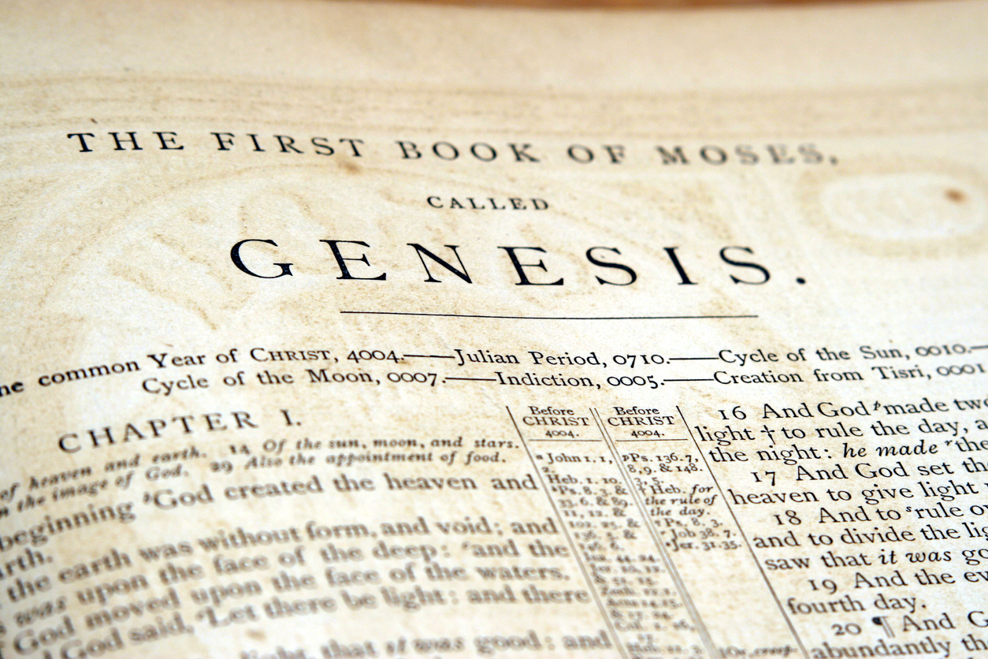
Why we NEED the O.T.
The REDEMPTION story STARTS and FLOWS through the OLD TESTAMENT starting in Genesis 3.15.
There is ONE GOD always the same in both the OLD Testament and the NEW Testament. Jesus Christ is the same yesterday and today and forever. Hebrews 13.8
The Old Testament is there to give us instructions and HOPE. For everything that was written in the past was written to teach us, so that through endurance and the encouragement of the Scriptures we might have HOPE. Romans 15.4
Notes:
Genesis 3.15.And I will put enmity between you and the woman, and between your offspring* and hers; he will crush* your head, and you will strike his heel.”
Hebrews 13.8 Jesus Christ is the same yesterday and today and forever. Marcionism c A.D. 144 The heresy Marcion preached was that the benevolent God of the Gospel who sent Jesus Christ into the world as the savior was the true Supreme Being, different and opposed to the malevolent Demiurge or creator god, identified with the Hebrew God of the Old Testament

Slide 11
O.T. How LONG NEEDED
NATION OF ISRAEL
LIFE OF CHRIST
PURPOSE: Therefore no one will be declared righteous in his sight by observing the law; rather, through the law we become conscious of SIN.
PENALTY: The PENALTY of the Law (O.T. rules and regulations) is death and eternal separation from God. ^{Rom. 6.23}
All without Christ Jesus as their savior are under the PENALTY of the O.T. law. ^{Jn. 14.6 Mt. 25.46}
PROMISE: “I saw in the night visions, and behold, … there came one like a SON OF MAN, ^{Dan. 7.13-14}
CREATION
THE LAW
GRACE of Christ
NEW CREATION
CAPTIVITY OF ISRAEL
CREATION
THE CHURCH AGE
Notes:
Daniel 7.13-14
“I saw in the night visions,
and* behold, with the clouds of heaven
there came one like a son of man,
and he came to the* Ancient of Days
and was presented before him.
[14] * And to him was given dominion
and glory and a kingdom,
that all* peoples, nations, and languages
should serve him;
* his dominion is an everlasting dominion,
which shall not pass away,
and his kingdom one
that shall not be destroyed.

Slide 12
O.T. How LONG NEEDED
“Do not think that I have come to abolish the Law or the Prophets; I have not come to abolish them but to FULFILL THEM. I tell you the truth, UNTIL heaven and earth disappear, not the smallest letter, not the least stroke of a pen, will by any means disappear from the Law UNTIL everything is ACCOMPLISHED. ^{Mt. 5.17-18}
For we must all appear before the JUDGMENT seat of Christ, that each one may receive what is due him for the things done while in the body, whether good or bad. ^{2 Cor. 5.10}

Slide 13
10¹⁷
2 Corinthians 1:20 says, “For no matter how many promises God has made, they are “YES” in Christ.”
The O.T. POINTS to Christ Jesus
The O.T. PROMISES Christ Jesus
The O.T. PROVES Christ Jesus
Over 300 O.T. PROPHECIES pointing to Christ Jesus.
Choose any 8 and the probability of this happening naturally is 10¹⁷ power.
10 × 10 × 10 × 10 × 10 × 10 × 10 × 10 × 10 × 10 × 10 × 10 × 10 × 10 × 10 × 10 × 10 = 100,000,000,000,000,000
Notes:
Points, Promise, & PROVES the Christ is Jesus!
Some scholars believe there are more than 300 prophecies about Jesus in the Old Testament. One site listed 351 specific prophecies fulfilled in Jesus Christ. These prophecies are specific enough that the mathematical probability of Jesus fulfilling even a handful of them, let alone all of them, is staggeringly improbable—if not impossible.
Peter Stoner, Chairman of the Departments of Mathematics and Astronomy at Pasadena College, was passionate about biblical prophecies. With 600 students from the InterVarsity Christian Fellowship, Stoner looked at eight specific prophecies about Jesus. They came up with extremely conservative probabilities for each one being fulfilled, and then considered the likelihood of Jesus fulfilling all eight of those prophecies.
The conclusion to his research was staggering. The prospect that anyone would satisfy those eight prophecies was just 1 in 10¹⁷. In Science Speaks, he described it like this:
"Let us try to visualize this chance. If you mark one of ten tickets, and place all of the tickets in a hat, and thoroughly stir them, and then ask a blindfolded man to draw one, his chance of getting the right ticket is one in ten. Suppose that we take 10¹⁷ silver dollars and lay them on the face of Texas. They will cover all of the state two feet deep. Now mark one of these silver dollars and stir the whole mass thoroughly, all over the state.
"Blindfold a man and tell him that he can travel as far as he wishes, but he must pick up one silver dollar and say that this is the right one. What chance would he have of getting the right one? Just the same chance that the prophets would have had of writing these eight prophecies and having them all come true in any one man, from their day to the present time, providing they wrote using their own wisdom.“
That is past hundreds, thousands, millions, billions, trillions, it is 100 quadrillion. That is a one followed by 15 zeros.
FYI: there is no real ZILLION. It is just a word used to represent a really large number like, well like a quadrillion.

Slide 14
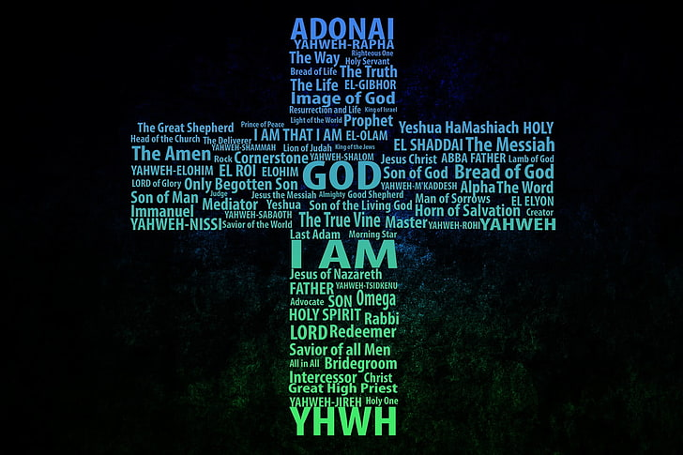
The Old Testament’s PURPOSE
The Old Testament is God’s gift PROCLAIMING His love and PLANS to make it POSSIBLE for anyone & everyone to know Him through His son, Jesus the Christ.
Notes:
The O.T. is the proclamation of God of the coming Messiah.
The O.T. is the plans he has prepared so we can know for sure this is of God.
The O.T. is the revealing of redemption through Jesus is possible for ALL.

Slide 15
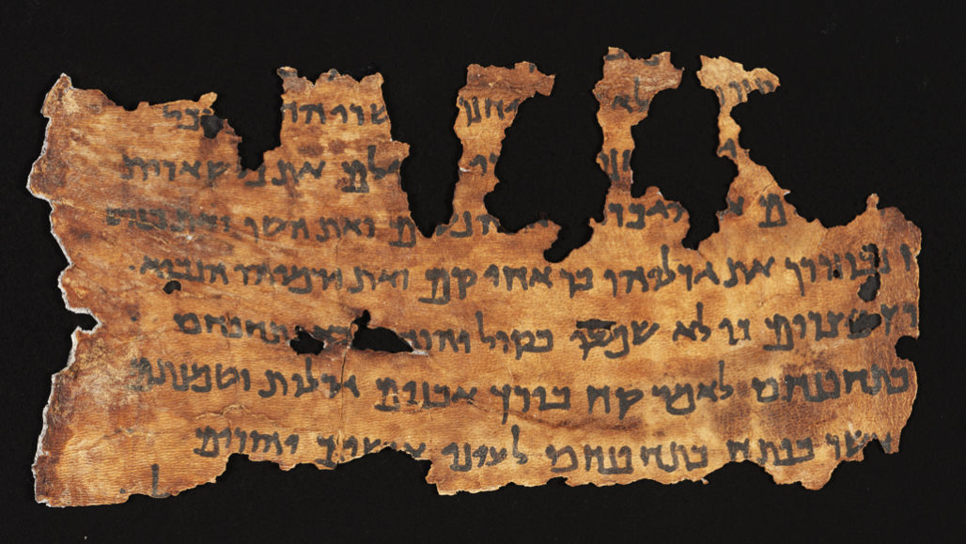
Prayer
I have stored up your word
in my heart,
that I might not sin against you.

Slide 16
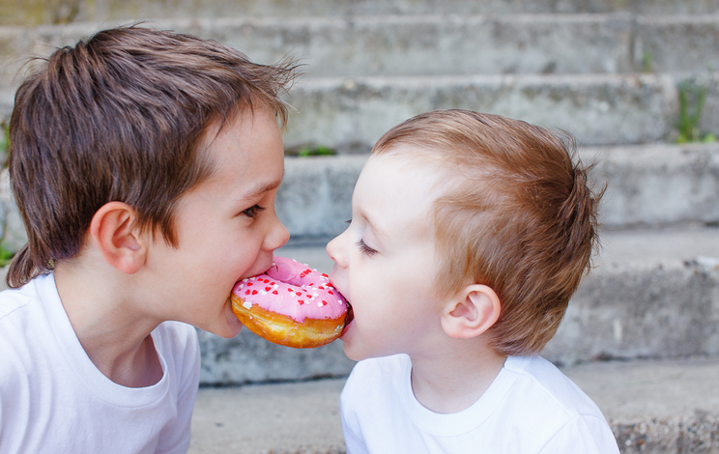
Sharing
Because of the service by which you have proved yourselves, men will praise God for the obedience that accompanies your confession of the gospel of Christ, and for your generosity in sharing with them and with everyone else. ^{2 Cor. 9.13}
Sonrisechurch.com and follow the directions on the giving tab.

Slide 17
Announcements
We have started our drive toward 100 Christmas shoeboxes for Samaritan Ministries operation Christmas Child this year.
Have you told a friend or family member about Sonrise in person or online and how they can be part of our Sunday services from anywhere?
We encourage you to support Sonrise church and our ministry by going to sonrisechurch.com.
GOD BLESS…
Notes:
Across the U.S., the project collected more than 7.8 million such gifts in 2020. Combined with those collected from partnering countries in 2020, the ministry is now sending more than 9.1 million shoebox gifts to children worldwide.

